Slide 1
fastGEN DESIGNER
Efektívný vývoj nových generácii fastGEN kitov
fastGEN meeting BRNO
22.3.2023
OPEN POSITION

Slide 2
Bioinformatické výzvy – fastGEN designer –
https://bioconductor.org/packages/devel/bioc/vignettes/ensembldb/inst/doc/coordinate-mapping.html
Example input (gene/transcr. and ROI codons):
PIK3CA (LRG_310p1) | 38
PIK3CA LRG_310p1 | 118
PIK3CA LRG_310p1 | 420
PIK3CA LRG_310p1 | 543 | 546
PIK3CA LRG_310p1 | 1043 | 1047
Sequence selection tool
Csv input table, gff hg38, fasta, settings AA -> chrom -> seq, python, R
Primer design Primer3 command line tool
settings
Multiplex tool
Blast
In silico PCR (pseudogenes)
Settings
Stand. Output table
dbSNP common check
databases
Python/shell/R script
Database download https://ftp.ncbi.nih.gov/snp/organisms/human_9606/VCF/
Tool ? Script ?
- Complex primer design and in silico testing in minutes and not days
Tune settings and re-run if necessary
Output :
Primers
Their parameters
Pooling information
fastGEN primers
Bed files for ROI, primers, etc.

Slide 3
https://github.com/rastiks/fastGENdesigner/
R Studio
R 4.2
BSgenome.Hsapiens.UCSC.hg38
Primer3
blast
(linux& mac tested, win not working properly)

Slide 4
MODUL 1 :
SEQUENCE SELECTION TOOL

Slide 5
Find the correct transcript (longest one)
https://www.lrg-sequence.org/
https://cancer.sanger.ac.uk/cosmic
protein
1 ENST00000477735 ENSP00000418145 MPPRPSSGELWGIHLMPPRIL PIK3CA
2 ENST00000263967 ENSP00000263967 MPPRPSSGELWGIHLMPPRI.. PIK3CA
3 ENST00000468036 ENSP00000417479 MPPRPSSGELWGIHLMPPRI.. PIK3CA
4 LRG_310t1 LRG_310p1 MPPRPSSGELWGIHLMPPRI.. PIK3CA
protein@listData[["protein_id"]] – TP53
[1] "ENSP00000410739" "ENSP00000488924" "ENSP00000352610" "ENSP00000484409" "ENSP00000478499" "ENSP00000481179"
[7] "ENSP00000484375" "ENSP00000481401" "ENSP00000477531" "ENSP00000478219" "ENSP00000269305" "ENSP00000481638"
[13] "ENSP00000398846" "ENSP00000391127" "ENSP00000482222" "ENSP00000480868" "ENSP00000391478" "ENSP00000482537"
[19] "ENSP00000458393" "ENSP00000425104" "ENSP00000423862" "ENSP00000424104" "ENSP00000473895" "ENSP00000426252"
[25] "ENSP00000482258" "ENSP00000482903" "LRG_321p1" "LRG_321p8" "LRG_321p1" "LRG_321p8"
[31] "LRG_321p3" "LRG_321p9" "LRG_321p10" "LRG_321p4" "LRG_321p11" "LRG_321p5"
[37] "LRG_321p12" "LRG_321p6" "LRG_321p13" "LRG_321p7" "LRG_321p8"

Slide 6
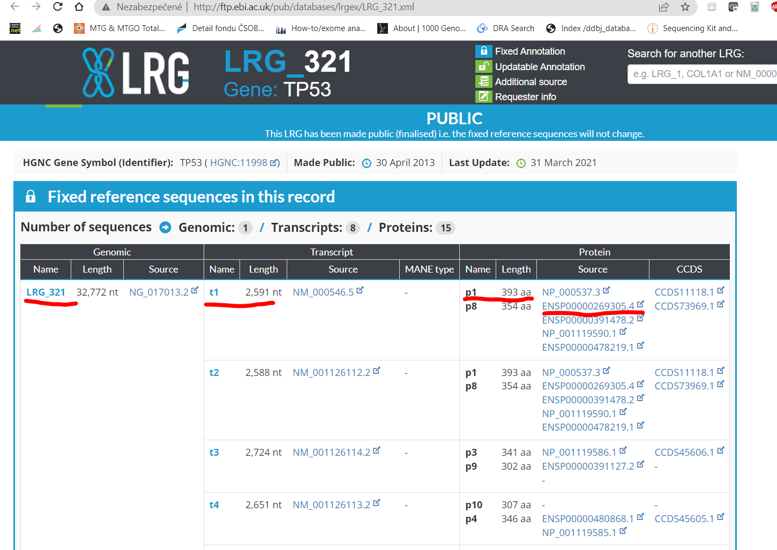

Slide 7
Input.txt
start stop gene/transcript/protein
38 38 LRG_310p1
81 111 LRG_310p1
118 118 LRG_310p1
344 350 LRG_310p1
391 391 LRG_310p1
418 420 LRG_310p1
453 453 LRG_310p1
539 546 LRG_310p1
726 726 LRG_310p1
1004 1025 LRG_310p1
1043 1049 LRG_310p1

Slide 8
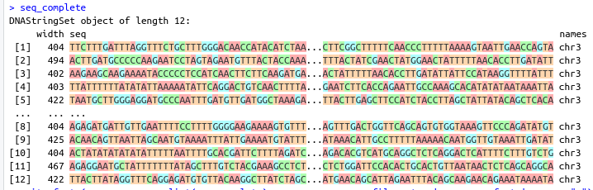
Outputs
ROI.bed
full_seq_ROI.bed
sequences.fasta
seq_complete(sekvencie na primer design)

Slide 9
MODUL 2 :
PRIMER PRIMER DESIGN

Slide 10
Input : seq_complete
Output :
sequences.fasta
primers.fasta (number of targets x 10)
primers.bed
df_primers_complete

Slide 11
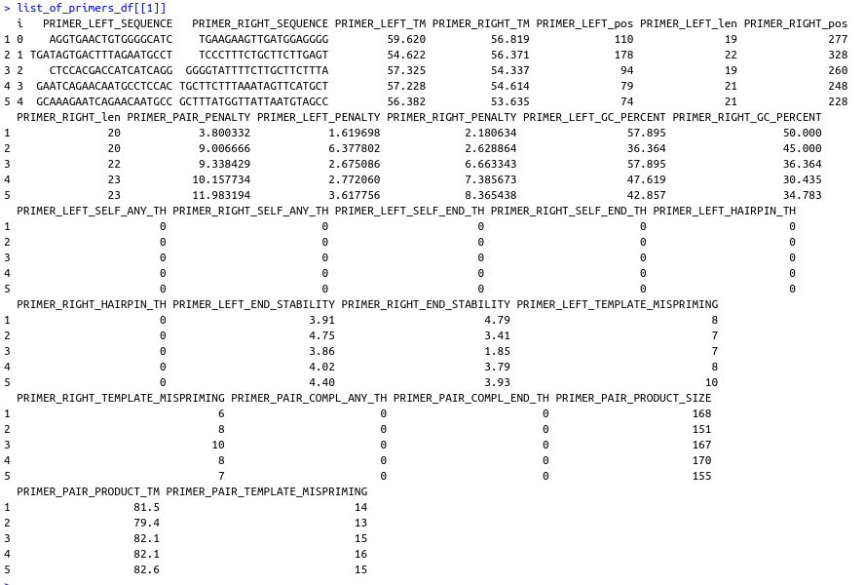

Slide 12
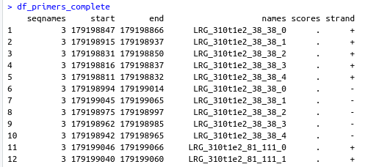

Slide 13
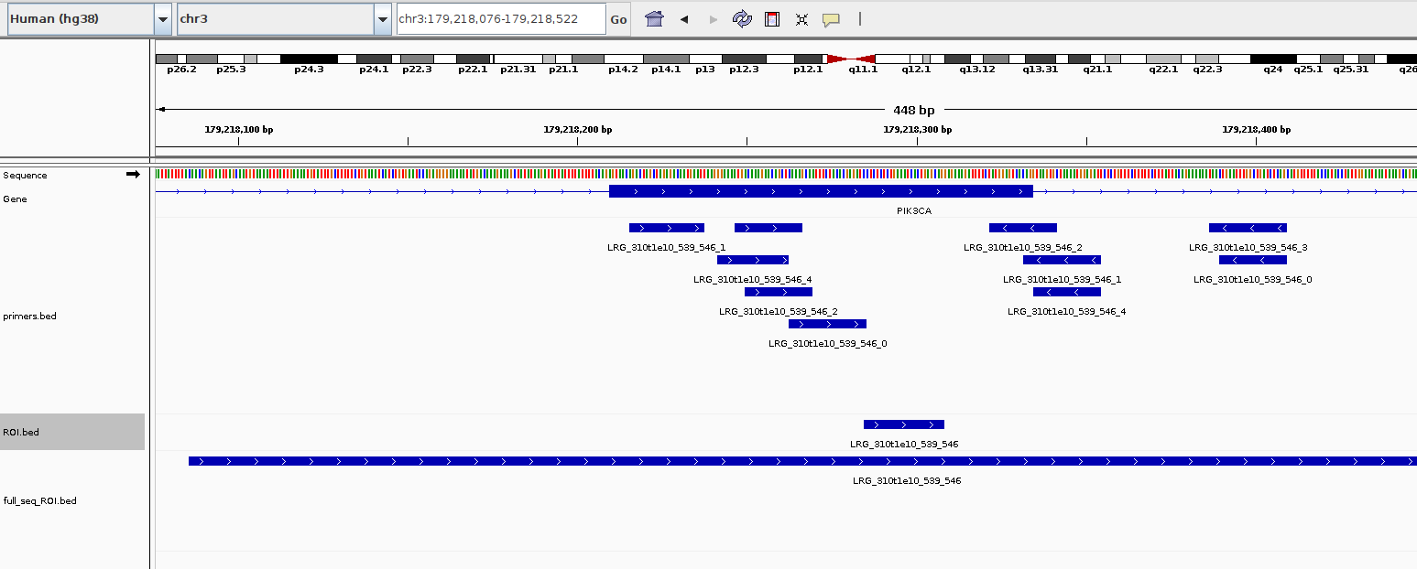
Visualisation of bed files

Slide 14
MODUL 3 :
PRIMER POOLER

Slide 15
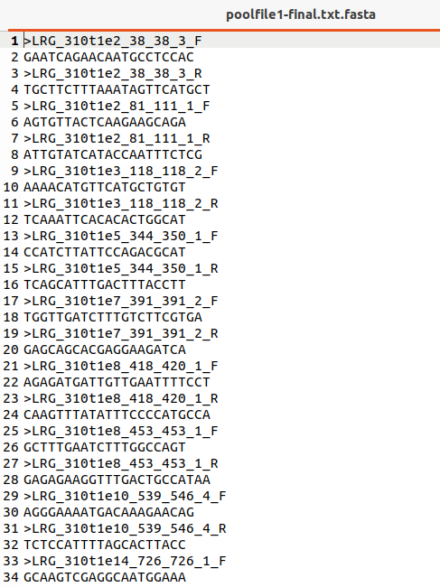
Input :
Primers.fasta (5 primer pairs per target)
Output :
poolfile1-final.txt.fasta (1 primer pair per target)

Slide 16
MODUL 4 :
BLAST

Slide 17
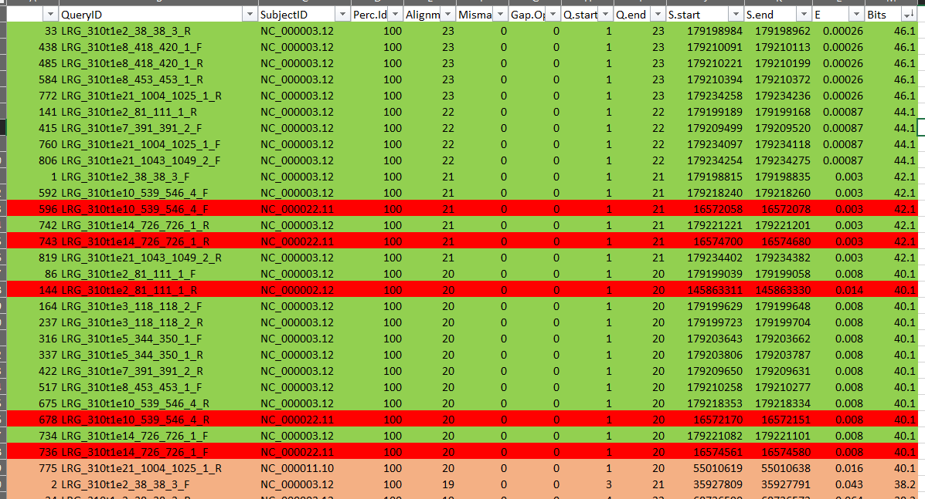
Input :
poolfile1-final.txt.fasta
Output :
blast.out.csv

